Slide 1
Next Generation Cloud Computing
David Reddick
Next Generation Cloud Computing: New Trends and Research Directions
Blesson Varghese and Rajkumar Buyya

Slide 2
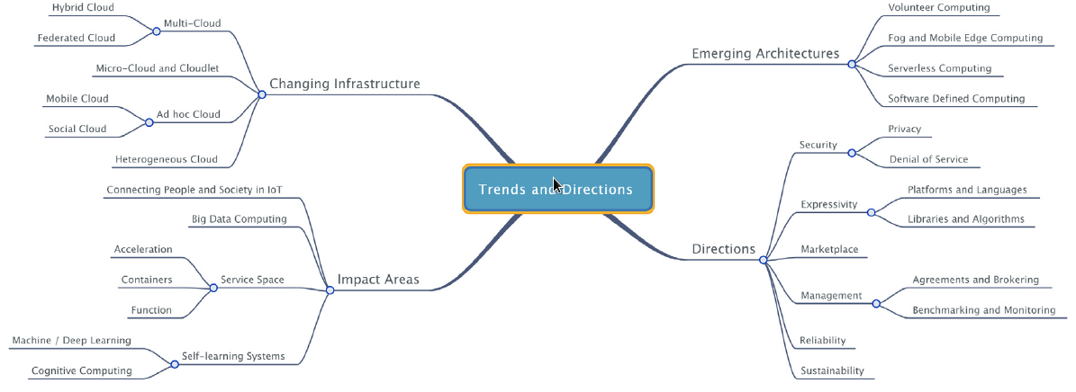
Outline
Introduction
Changing Infrastructure
Emerging Computing Architecture
Avenues of Impact
Future Research Directions
Critique

Slide 3
Introduction
How the roles of cloud computing are changing
Trend toward heterogeneous resources

Slide 4
Outline
Introduction
Changing Infrastructure
Emerging Computing Architecture
Impact Areas
Directions
Critique

Slide 5
Changing Infrastructure
Current infrastructure
Single Provider
Data Centers
Centralized
Privacy and Security
Require mitigating
Notes:
Current infrastructure has dedicated compute and storage resources located in large energy consuming data centers that are centralized and thus susceptible to single point of failures.
These data centers are also often far away from the users, potentially in another country that could affect the privacy and security of the data.
To mitigate, the chances of failures, redundant data centers potentially in different zones.
Alternativly, the a user may want to replicate important data to multiple cloud providers to further reduce risk.
The paper considers nine layers of abstraction that contribute to the cloud stack, namely network which is the bottom of the stack, storage, servers, virtualisation, operating system, middleware, runtime, data and application which is the top of the stack.
For facilitating multi-cloud environments and ad hoc clouds, changes will be required from the middleware layer and upwards in the stack.
It is also noted that there has been significant changes in the area of data storage.
This is broken down into block level like Amazon EC2, file level level like Google Storage, and the database level like Google Cloud SQL.

Slide 6
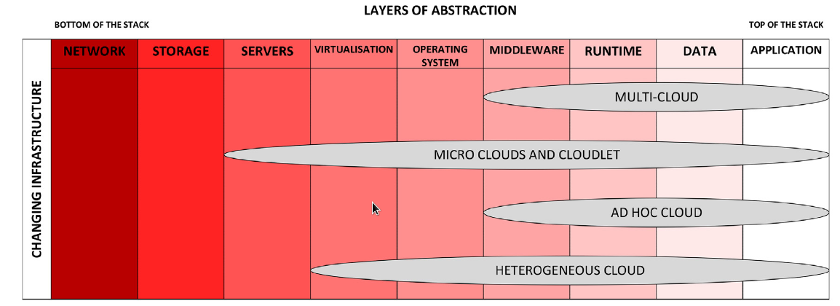
Changing Infrastructure
Notes:
I will now discuss the different types of cloud infrastructure.
The first type I will discuss is Multi-Cloud which is further broken down into Hybrid Cloud and Federated Cloud.
As you can see in the graph, multi-cloud utilizes the application through the middleware layer.
Next I will discuss Micro clouds and cloudlets which utilize the application through the server layer.
After that I will discuss Ad hoc clouds that are similar when it comes to layer abstractions to multi-cloud and utilize the application through the middleware layer.
Finally I will discuss Heterogeneous clouds which use the application through the virtualization layers.

Slide 7
Changing Infrastructure: Multi-Cloud
Traditionally only different data centers
Applications are spread across multiple clouds
Many difficulties of using multiple providers
Consistency
Billing
Ease
Potential Solutions
APIs
Notes:
Historically when referring to multi-cloud, an individual was referring to utilizing multiple distinct data centers of a single cloud provider, however today applications are hosted on multiple providers for multiple reasons including better resiliency.
In fact, the article mentioned that at the time this article was published in 2018, the average business utilized an average of six cloud providers.
However the advantages of using multiple cloud providers are not pain free.
Currently, APIs meant to help ease multi-cloud deployments are limited by the fact they need to know different types of resources available for each provider used and the needed information is often not public and can change often without notice.
Also, the abstractions, including network and storage architectures along with the different resources, hypervisors, and software suites employed differ across providers which make consistent application deployments difficult.
Pricing and billing models may also vary greatly between providers.
All management tasks, such as fault tolerance, load balancing, resource management and accounting need to be programmed manually also since there are no unifying environments that make these possible.
However, advancement in APIs like Libcloud and jCloud will hopefully remove many of these problems in the future.

Slide 8
Changing Infrastructure: Hybrid Cloud
Type of Multi-Cloud
Combination of private and public cloud/infrastructure
Great for busty demands or predictable demands
Beneficial for handling sensitive data
Network infrastructure problems
Notes:
Hybrid cloud are a subtype of multi-clouds by combining private and public cloud and IT infrastructures together.
This type of cloud are great for busty demands or predictable loads.
However the greatest drawn to hybrid cloud is for handling sensitive data for industries like healthcare and the energy sector.
In fact, the author noted that it is estimated that 63% id organizations who use the cloud deploy a hybrid cloud.
The biggest problem thou is network infrastructures with bandwidth, latency and network topologies playing a big factor.
For some deployments, the dedicated networking between clouds may be a better solution then hybrid clouds.

Slide 9
Changing Infrastructure: Federated Cloud
Type of Multi-Cloud
Collaboration of different cloud providers under single pane
Makes applications inoperable and portable
Ease of migration
Popular with small providers
May include non traditional compute sources
Notes:
Federated clouds are another subtype of multi-clouds that combine different cloud providers under a single plane interface.
This is often done as a collaberation of many smaller cloud providers who work togther to get a larger coverage then they would alone.
Howver, large cloud providers like AWS do not usually participae in federated clouds.
This can provide a catalogue of services and resources available as well as makes applications interoperable and portable.
A successful example of a federated cloud is the European based EGI Federated Cloud which is made up of over 20 cloud providers and 300 data centers.
Federated clouds can address the vendor lock-in problems in that applications and data can be migrated from one cloud to another.
More recently, there are ongoing efforts to federate resources that are located outside cloud data centers.

Slide 10
Changing Infrastructure: Microcloud and Cloudlet
Traditional computing centralized to powerful data centers
Instead uses cheaper and low power alternative
Allows pushing computing closer to the edge
No current public deployment
Notes:
Traditional data centers occupy large amounts of land and consume lot of energy to run and cool.
Alternativly, microcloud propose to use low clost and low power devices and move the computation closer to the edge.
This would be made up of small sized,low cost and low power computing processors co-located with routers and switches or located in dedicated spaces closer to user devices.
Currently thou there is no public deployments because of the challenges in networking microcloud installations over multiple sites.

Slide 11
Changing Infrastructure: Microcloud
Designed to reduce latency and reduce backhaul to data centers
Able to use low cost devices
Work in conjunction with data centers
Problems with reliability and availability
Notes:
Microclouds lend themselves in reducing latency of applications and minimising the frequency of communication between user devices and data centers.
An example of possible devices that could be used is the ever popular Rasberry Pi.
These deployments are not a replacement for data centers and would instea complement them.
One of the challenges is in using microclouds (that may or may not be always available) with network management abstraction between the cloud and the edge without depending on the underlying hardware.

Slide 12
Changing Infrastructure: Cloudlet
Similar to microcloud
Extends infrastructure closer to the edge
For mobile computing
Improve latency and QoS
Serve local traffic and reduce network load
Notes:
The aim of a cloudlet is similar to a microcloud in extending cloud infrastructure towards the edge of the network but is instead only used for mobile computing.
One use is improving the latency and Quality of service (QoS) of mobile applications.
By integrating cloudlets, the network would be able to server local traffic and reduce network traffic toward cloud data centers beyond the first network hop.
One of the few active deployments of this technolofy is the Elijah project.

Slide 13
Changing Infrastructure: Ad Hoc Cloud
Will be leveraged for microclouds and cloudlets
Been around for many years
Utilizes otherwise idle resources
Elastic compared to traditional computing
Prevalence of mobile devices make this a possibility
Inherently unreliable
Notes:
The future deployment of microclouds and cloudlets will need to utilize ad hoc computing to be successful.
Ad hoc networking is actually not a new technology and has been around for years since the grid era.
A popular and well known example is SETI@home and Folding@home, the later of which has come into limelight due to the Conrona virus.
Unused spare resouses on a device is able to be put toward a distributed goal with a software like BOINC.
This is in contrast to existing cloud infrastructure which is largely data center based and in which the resources available are known beforehand.

Slide 14
Changing Infrastructure: Heterogeneous Cloud
Two different definitions
Use of multiple cloud providers
Low level hardware variance
Super computers are more likely to be heterogeneous
Cloud data centers slowly adopting
Not currently possible to program without knowing hardware being used
Current applications can not be easily moved to heterogeneous cloud

Slide 15
Outline
Introduction
Changing Infrastructure
Emerging Computing Architecture
Impact Areas
Directions
Critique

Slide 16
Emerging Computing Architecture
Current infrastructure
End nodes utilize services on the cloud
Business and database logic on the cloud
Increasing number of devices in use
Centralized unable to solve all problems
Quality of Service (QoS) and Quality of Experience (QoE)
Expand toward user

Slide 17
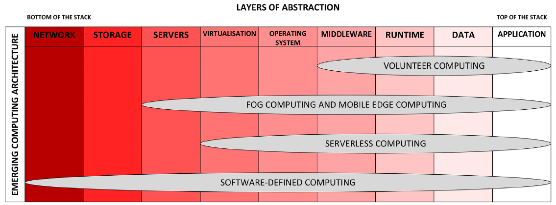
Emerging Computing Architecture

Slide 18
Emerging Computing Architecture: Volunteer Computing
Traditional service guarantees do not apply
Crowd funding spare resources are volunteered
Support scientific or societal goals
Usually heterogeneous
Need to simplify deployment
Resolve privacy and security concerns

Slide 19
Emerging Computing Architecture: Fog and Mobile Edge Computing
Leverage existing compute resources at edge
Resource constrained
Minimize latency and improve QoS/QoE
Advantageous to the realization of IoT potential
Will not replace centralized cloud computing
Helps with aggregation

Slide 20
Emerging Computing Architecture: Mobile Edge Computing (MEC)
Utilizes edge like fog
Only uses mobile networks and not entire network
Radio access network may be shared to reduce network congestion
Possible uses to lower latency content delivery, data analytics and offloading, and improved response time

Slide 21
Emerging Computing Architecture: Fog and Mobile Edge Computing
Problems
Complex management
Service agreements
Responsibilities
Platform control
Security and privacy

Slide 22
Emerging Computing Architecture: Serverless Computing
Traditional cloud has applications hosted on VMs
Server owner pays for entire time
Not ideal to require provisioning and instead modular
Instead charges for memory used when executed and number of request processed
Not actually “Serverless”

Slide 23
Emerging Computing Architecture: Serverless Computing
Server is not rented like a traditional type and instead abstracted away
Application executed only when necessary
Function-as-a-Service or event-based programming
Traditional not ideal with number of new devices that are being added
Requires a shift to modular programming
Programming for high level abstraction

Slide 24
Emerging Computing Architecture: Software-Defined Computing
Rapid increase in number of devices is problematic for traditional cloud compute setups
Software Defined Networking (SDN)
Supports dynamic architecture
Allows programming of the control components of the network

Slide 25
Emerging Computing Architecture: Software-Defined Computing
Challenges
Development of hybrid SDN
Enhance end-to-end QoS
Interoperability with Information-Concentric-Networks (ICN)
Facilitate network virtualization
Software Defined Computing (SDC)
Applied to compute, storage, and network of a data center

Slide 26
Outline
Introduction
Changing Infrastructure
Emerging Computing Architecture
Impact Areas
Directions
Critique

Slide 27
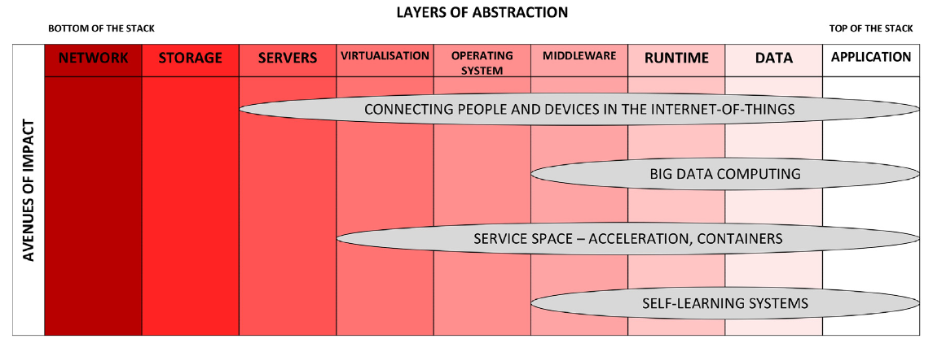
Impact Areas

Slide 28
Impact Areas: Connecting People and Devices in the IoT
Innovation required because of rapid increase in number of sensors and gadgets
Goal of IoT is to improve accuracy and efficiency with less human intervention
Facilitate IoT with combination of cloud architectures
Need end-to-end security
Protect against outside attacks but also malicious attacks
Require secure programming

Slide 29
Impact Areas: Big Data Computing
More efficient often to process closer to source
Challenges
Low effort use of heterogeneous architecture
Need to be able to scale
Need software for end-to-end processing
Mainly unstructured compared to structured
Convert to structured then to knowledge
Data-to-network-to-knowledge (D2N2K)

Slide 30
Impact Areas: Service Space
Traditionally service space is an abstraction of infrastructure, platform, and software
Acceleration-as-a-Service (AaaS)
GPU (CUDA or OpenGL), FPGA, ASIC
Container-as-a-Service (CaaS)
Needed for ad hoc and microclouds
Alternative visualization
Function-as-a-Service (FaaS)
Execute functions only when initiated

Slide 31
Impact Areas: Self-Learning Systems
Using deep learning
Process photos, audio, and videos uploaded to cloud
Traditional machine learning restricted to large computation clusters
New APIs and libraries cost less when used with accelerators

Slide 32
Outline
Introduction
Changing Infrastructure
Emerging Computing Architecture
Impact Areas
Future Directions
Critique

Slide 33
Future Directions
Enhanced Security
Design applications for upcoming technologies
Develop marketplace
Easier management strategies
Reliability of cloud systems
Ensure sustainable infrastructure

Slide 34
Outline
Introduction
Changing Infrastructure
Emerging Computing Architecture
Impact Areas
Future Directions
Critique

Slide 35
Critique
The main sections were clear what was going to be discussed
Language choice on some sentences could be improved for easier reading
Mentions problems but doesn’t work toward a solution
Should have constrained the paper to either changing infrastructures, emerging architectures, or impact areas
Some sub sections should have been broken up
Overall this paper was a thorough investigation of the field

Slide 36
Reference
Varghese, Blesson, and Rajkumar Buyya. “Next Generation Cloud Computing: New Trends and Research Directions.” Future Generation Computer Systems, vol. 79, 2018, pp. 849–861., doi:10.1016/j.future.2017.09.020.

