Slide 1
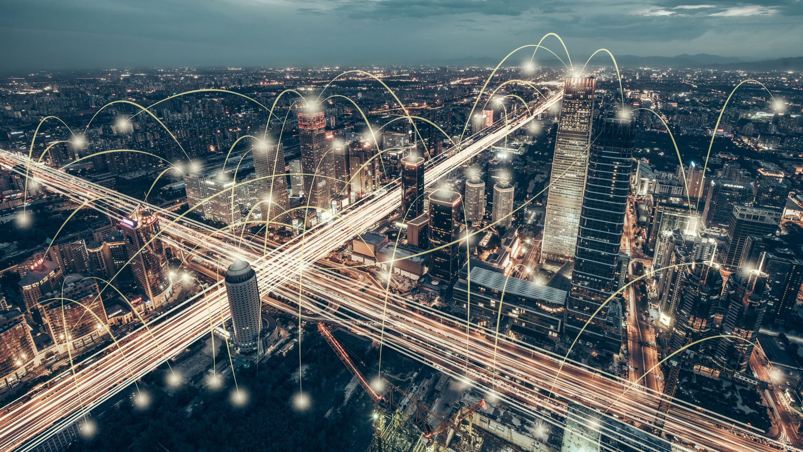
IoT and 5G
Sina Sontowski

Slide 2
Research Question
What are some of the network challenges and requirements to ensure IoT connectivity through 5G?

Slide 3
Problem Statement
IoT emerging and promising technology
Interconnect devices with many using cellular technologies such as 2G, 3G, and 4G
Currently used by IoT but not fully optimized for IoT applications
IoT devices introduce unique challenges
Challenge on how 5G mobile networks will meet diverse requirements of IoT
Next generation 5G mobile networks ensure that massive devices and new services are efficiently supported

Slide 4
Overview
Background IoT
IoT application requirements
Latency Critical IoT
Characteristics of IoT
IoT Design Requirements
IoT Challenges
5G Networks for IoT
Existing Networks
Cellular Technology
Network Enabler
NDN
SDN
Research Challenges and Future Directions

Slide 5
IoT Application Requirements [1]
Smart Home
Intelligent Transportation Systems
Industrial
Smart Healthcare

Slide 6
Smart Home
Devices connected to internet and decisions are autonomously based on sensor info
For example, potentially switch appliance ON or OFF over internet to preserve energy
Communicate regularly with environment (internal and external)
Internal: internet connected smart devices and home appliances
External: not in control of smart home (like smart grid entities)
ZigBee most popular standard
Main application domain

Slide 7
Intelligent Transportation System
Ensure transportation network efficiently monitored and controlled
Uses lots of network components such as vehicle subsystem (GPS), radio frequency identification reader, on board unit, ITS monitoring unit, station subsystem (road-side equipment), security subsystem
Overall goal to ensure that system reliability, availability, efficiency, and safety of transportation network are guaranteed
Research involves autonomous cars
Working on development of vehicle-to-vehicle communication
Notes:
Ex real-time parking management,
speed alerts, electronic toll collection,
RFID radio waves to identify people for automated ticketing (far away car, not in sight)
on board unit for toll purposes

Slide 8
Industrial
Data reliability is key and needs to be high (not necessary for smart home and ITS)
Strict time constraints, low latency and jitter for applications like motion control
Low-power wireless networks can’t fulfill requirements of high reliability and small energy consumption
IP protocol stack for end-to-end not adapted to requirements of constrained devices
Proprietary solutions which limit interoperability, while other domains use standardized protocols more extensively
Notes:
SCADA systems
EX:

Slide 9
Smart Healthcare
Connected healthcare: sensors attached to patients to collect medical data and vital signs to diagnose conditions, track progress, and indicate anomalies directly to healthcare provider
Reduces human intervention
Simplifies process of collecting patient data
Provides lots of quantity of data to advance scientific studies in disease cures and diagnosis
Example: tracking hand washing via IBM’s RFID technology
Notes:
Wear RFID badge
Hand wash stations every point have RFID reader, every time washed reader records users identity and length of stay in front of reader

Slide 10
Overview of typical characteristics/requirements of IoT application [1]
Notes:
Differences in requirements
IoT compromises diverse set of applications with varying requirements
Delay tolerant applications but also some that require low latency and high reliability
So heterogenous
Different applications require different reporting intervals
Like alarms in homes update interval much higher than smart cities where only daily uploads

Slide 11
Latency and 5G
Responsiveness of network
How fast each conversation is
5G different from previous generations of cellular technology because it will be faster
High latency can be inefficient for some users
Gaming – we don’t want lag
5G enables send and download huge amounts of data in near real time
Ex: First responders faster access to critical info to perform life saving efforts

Slide 12
Latency Critical IoT Use Cases and Requirements [2]
Factory Automation
Process Automation
Smart Grids
Intelligent Transport Systems
Professional Audio

Slide 13
Latency Critical Use Cases Continued
Factory Automation – real-time control of machines, machine parts in motion within limited space
High Speed Assembly
Highly challenging in terms of latency and reliability demands
Process Automation – monitoring and diagnostics of industrial elements and processes (heating, cooling etc)
Measured values change slowly
Not as high of latency requirements but communication range is longer (multiple buildings)

Slide 14
Latency Critical Use Cases Continued
Smart Grids – less stringent requirements compared to factory automation applications
Communication range much longer (up to a few km)
Intelligent Transport System – autonomous driving, road safety, traffic efficiency
Warning other road devices about collisions; coordination of actions
Small latency and high reliability

Slide 15
Latency Critical Use Cases Continued
Professional Audio – live concerts demand extremely low latency in transmission links
Trained musicians find latency exceeding 4ms between sound generation and tonal perception as disturbing

Slide 17
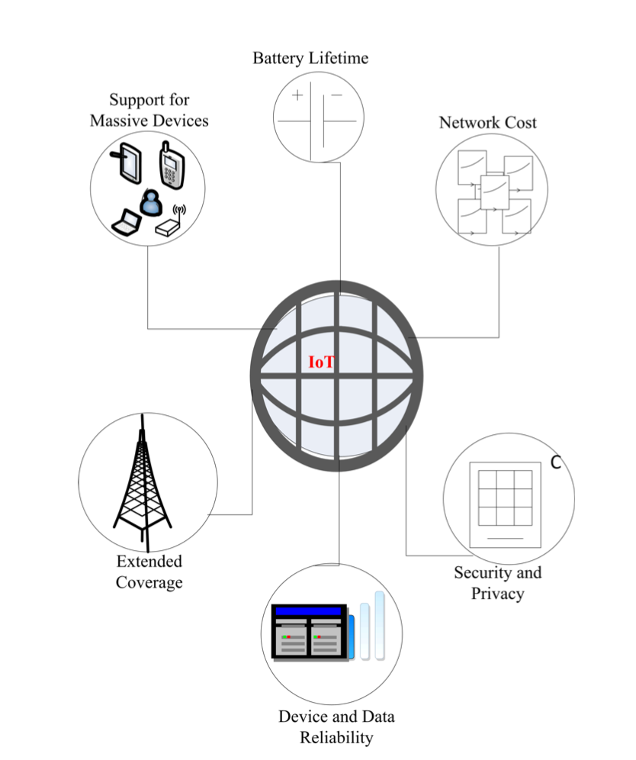
IoT Design Requirements [1]
Low Device Cost
Low Deployment Cost
Long Battery Life
Extended Coverage
Security and Privacy
Support for Massive Number of Devices
Notes:
Considering massive deployment of these services including low device cost……

Slide 18
IoT Challenges [3]
Complex Solutions to Simple Communication Needs
Limitations of Channel- and Session-based Security
Poor Integration of Local Communication

Slide 19
Complex Solutions to Simple Communication Needs
What makes it complex: communication technology diversity and resource constraints
Significant amount of effort expended in current systems to get devices to communicate by using existing protocol suite
JUST to communicate not even work with them yet
Dynamically changing environment

Slide 20
Limitations of Channel and Session Based Security
Security approaches used in common internet applications are not a good fit for IoT
IoT made up of heterogenous devices, overlapping networks with different administrative domains and intermittent connectivity via multiple communication channels per device
Securing channel or session between devices does not tackle how to express identity of a thing beyond address of devices
How handle key distribution itself?
Integrity between communication elements?

Slide 21
Poor Integration of Local Communication
Network layer responsible for providing efficient support for direct communication between nearby IoT nodes
Problems if any of the hosts changes in participation in unicast communications (broadcast nature of wireless media for IoT communications)
Typical IoT involves multiple overlapping local communication domains (one for each wireless and wired medium), requires subnetting for example
Host-to-host may work for some particular network but not in broader sense

Slide 22
Existing IoT Communication Networks [1]
Long Range Networks
LoRa
SigFox
Ingenu-RPMA
DASH7
WEIGHTLESS
Notes:
Main features of currently prominent technologies for IoT and catergorizes into long-range networks and short-range networks and cellular technology
Long range networks support low-power and low-range connectivity solution for IoT applications

Slide 23
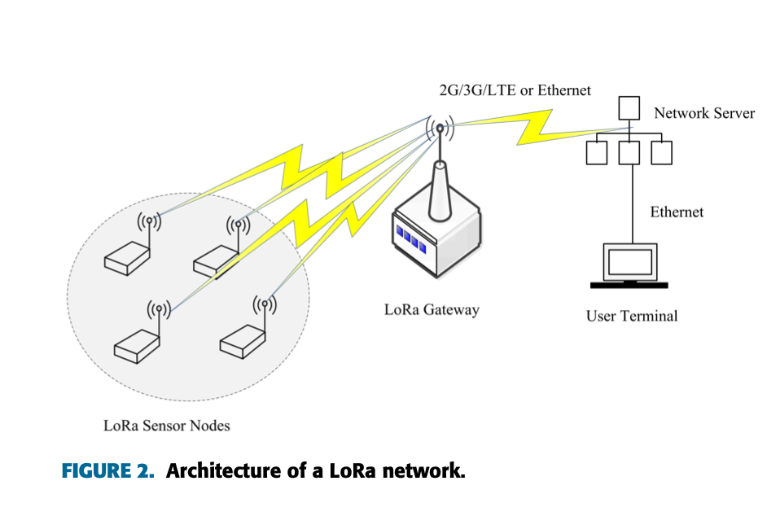
LoRa
Specifically for IoT
low-cost, low-power, long range
Star-to-star network
Add network layer to handle network congestion between end devices and central nodes

Slide 24
Existing IoT Communication Networks [1]
Short Range Networks
Bluetooth
IEEE 802.15.4 and ZigBee
Wi-Fi
Notes:
Viable and best fit for for consumer use cases of IoT, may not be able to support for civic, industrial, and other related IoT applications for which demands are beyond capacity of their characteristic feature
Data rate: speed of data transfer through a channel, data rate dependent on bandwidth; higher bandwitdth higher throughput, bigger is faster but tradeoff with range; higher more interference

Slide 25
Cellular Networks
1G (1st Generation) – analogue, mid 80s, only voice calls, limited capacity to serve everyone
2G (voice) – early 90s, digital technology, phone calls, text messaging, limited amounts of data using protocol called GPRS
3G (data) – additional features mobile Internet access, video calls, mobile TV, transferring of info through data such as images and video, higher frequency so shorter range than 2G
4G – late 200s, faster speeds than 3G but less coverage, high-definition mobile TV, video conferencing, users sharing available sector capacity

Slide 26
5G
Faster upload and download speeds because lower latency
wider bandwidth size – 5G support more devices
Higher capacity per sector
Lots of small cell sites – more visible infrastructure
Huge capacity (can handle high monthly usages of homes for example)
Compared to Wi-Fi: Wi-Fi (LAN) has lower speed but cheaper to deploy, 5G (WAN) for longer range

Slide 27
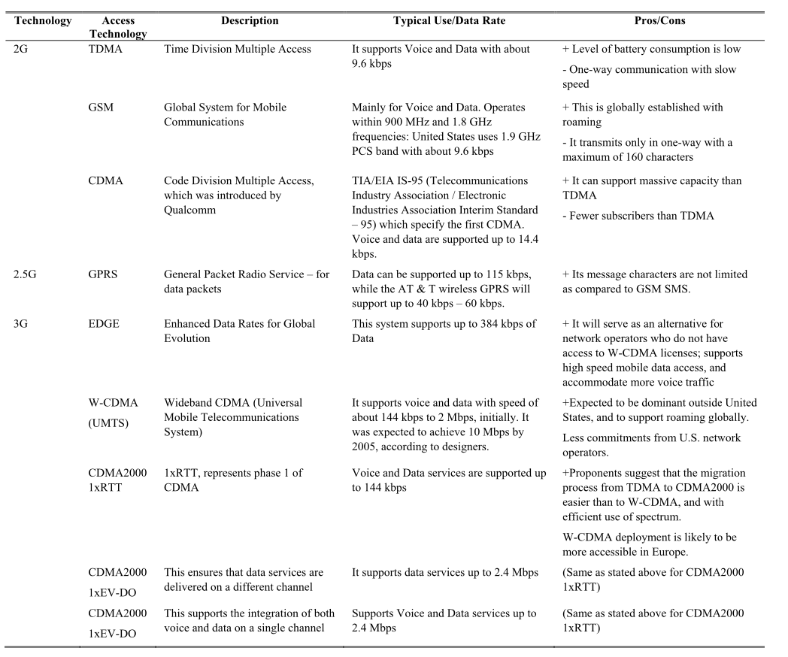
Cellular Technology [1]
2G Cellular Networks
3G Cellular Networks
Notes:
Vending Machines, Smart Metering, Automatotive Systems, smart home are provided by cellular technology

Slide 28
Network Enabler for the Internet of Things [1]
Software-Defined Wireless Sensor Network
Network Function Virtualization
Cognitive Radio Networks
Notes:
New service requrirements, based on wearable things, low latency, high versatility, scalability, efficiently enabling Massive to Cirtical IoT applications
However conventional network structures is outdated to support these features for IOT architecture, network ever changing, current don’t enable ever-growing network technologies

Slide 29
Software Defined Wireless Sensor Networks
Low-rate personal wireless personal area networks
SDN into existing wireless sensor networks
SDN future tech enabler for next generation 5G mobile networks
SDN used to Decentralize control logic plane from network device
Switch and enable external network controller to define nature and behavior of network forwarding infrastructure (routing)
SDN makes it easier for introduction and deployment of new application services and enables flexibility of network management that supports exponential traffic growth of 5G networks

Slide 30
Software Defined Wireless Sensor Networks Continued
WSN expected to be vital enabler for IoT systems
b/c sensor nodes are main entity for this concept
SDWSN key network enabler technology to address issue of flexibility and interoperability of future multi-vendor infrastructure in 5G for IoT
Massive to Critical IoT network architectures need to be enhanced to accommodate, manage, and control large large number of heterogeneous devices and inflow of data
SDWSN simplify entire network infrastructure, manage control system requirements, maintain heterogeneity to enable future IoT cases

Slide 31
Network Function Virtualization
Highly complementary to SDN
Enabling network technology for next generation service requirements for IoT but not dependent on each other
NFV implemented without considering SDN and vice versa
Both solutions combined to achieve optimal performance
Perspective of Virtual Machines (decouples network functions from hardware)
Virtualize a set of network functions which can be implemented into software packages to provide related service requirements
Efficiently enable massive deployment of devices
Servers or cloud

Slide 32
Source: CodiLime.com

Slide 33
Cognitive Radio Networks
Utilize limited and scare resources to support increasing demand for new service requirements of emerging and promising IoT applications
CR supports capability of sharing licensed spectrum in opportunistic manner
Enables identification of available free spectrum and detection of licenses users present in system, select best available channel, coordinate accessibility to available channel with other users and vacate accessed channel on arrival of primary user
Connectivity solutions for unserved and underserved geographical locations

Slide 34
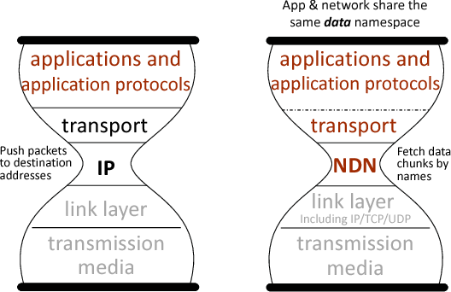
NDN
No more IP addresses
Content based, not where but what
Directly retrieves object by name
Secures data from user to actual data (TLS only encrypts channel)
Lower latency because sends over named data pipe

Slide 35
Applying NDN Architecture to IoT [3]
Basic Protocol: Named Data Retrieval
Data-centric Security
Name-based Forwarding
In-network Storage

Slide 36
Applying NDN Architecture to IoT Continued
Named Data Retrieval – retrieving named data naturally matches semantics of IoT applications, thing identified in name
Data Centric Security – directly secure named data at network layer, securing data rather than channel which allows more security between heterogenous network environments
Name-Based Forwarding – forwards based on name, operate directly on packets that describe things and their data
In-network storage – opportunistically cache data packets that are forwarded, persistent data repositories which is long-term managed storage for data

Slide 37
Achieving IoT Framework Functionality [3]
Naming Things, Devices, and their Data
Bootstrapping and Discovery
Schematizing Trust
Name-Based Access Control
Data Aggregation
Application-Level Publish-Subscribe
Sync: Efficient Multi-Party Communication
Integration IoT with Global Internet

Slide 38
SDN
Separation of network control plane (manages network) from data plane (traffic flows)
Fine-tuned for specific applications
Security installed on each individual network
Help IoT by segmenting network traffic and help organize the data

Slide 39
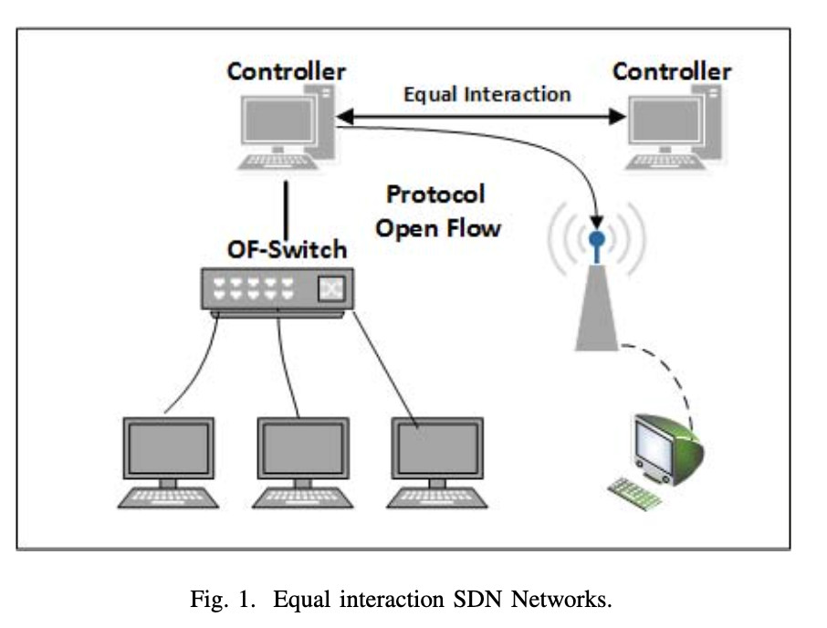
The Software Defined Network [4]
SDN Controller manages flow control to the switches for improved network management
Tells switches where to send packets
Simple Point of Failure with only one controller
Synchronized Multiple Controllers: each controller partial view and back up

Slide 40
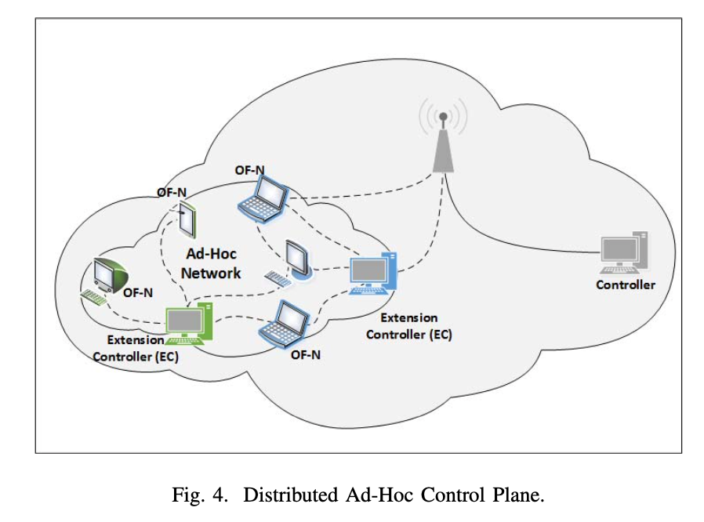
SDN Based Ad-Hoc Architecture [4]
SDN Architecture for Ad-Hoc Network
Distributed Ad-Hoc Control Plane: multiple controllers
Share same global network view but functions and management limited to small Ad-Hoc area
Faster response to network changes
React to attacks
Intend to include smart objects

Slide 41
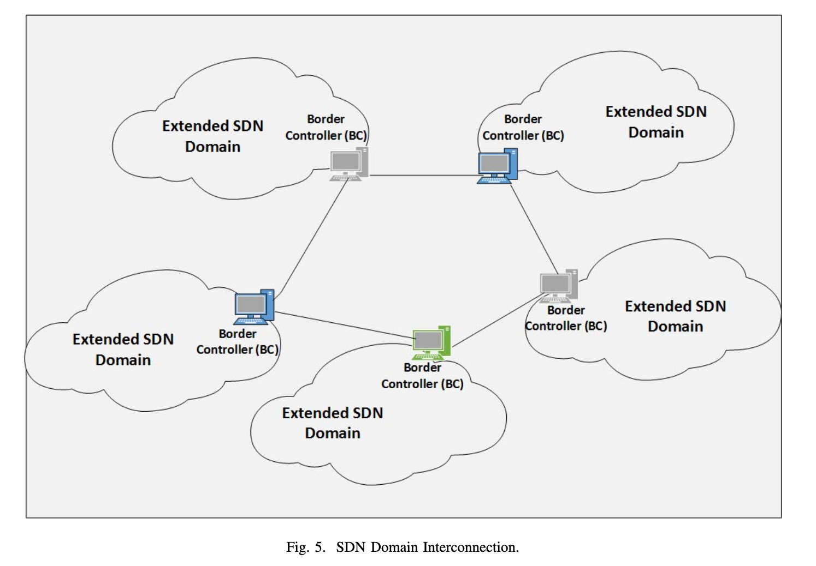
SDN Based Architecture for IoT [4]
SDN Domain
Each device can be associated with one neighboring node which has SDN capabilities
SDN Domain interconnection
Root controller/border controller: distribute routing functions and security rules, responsible for establishing connections and exchanging information with other SDN border controllers

Slide 42
Distributed SDN Security Solution [4]
Grid of Security concept to solve security problems of interconnected SDN Domains (each own security policies)
Extend SDN Domain concept to multiple domains
Controllers know policies in their domain but don’t know policies of other domains
Only recognized traffic accepted
Security controller asks each neighbor controller if it knows destination of the information
To open communication port, make request to SDN controller

Slide 43
Relation to 5G [2]
Not only improve radio interface design
SDN and NFV enabling flexible and scalable architecture, adjusted to needs of several use cases, concurrently on same infrastructure
Network slices form appropriate subsets of network resources and settings
Incorporating SDN and NFV concepts

Slide 44
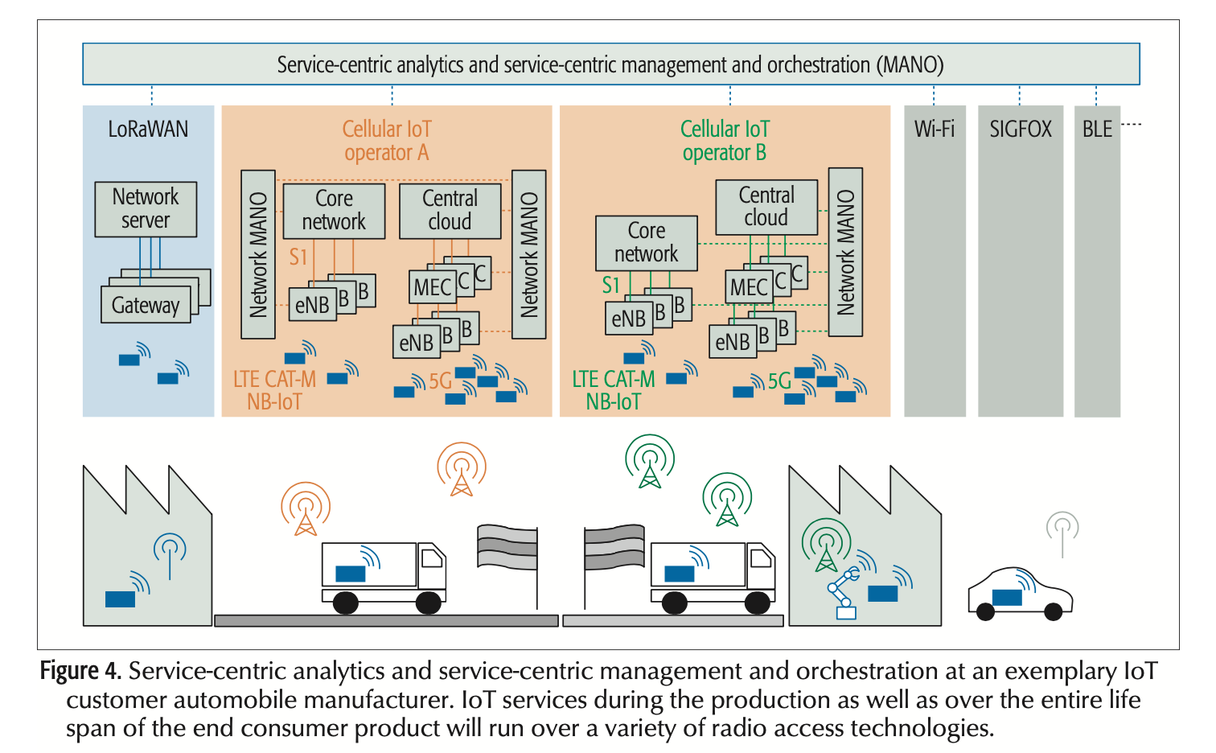
Network Architecture for ultra-low latency [2]
IoT wearing components manufactured at different production sites and transferred between sites and monitored
Heterogeneity of communication requirements
Variety of radio technologies and multiple Wi-Fi
Interoperability is key
Interfacing with as wide as possible SDN/NFV network architecture

Slide 45
Research Challenges and Future Directions [1]
Scalability
Network Management
Interoperability and Heterogeneity
Security and Privacy
Network Mobility and Coverage
Network Congestion and Overload

Slide 46
In Detail Research Challenges
Scalability – introducing new devices without compromising quality
Network Management - massive number of connected devices and diversity pose major management requirements
Interoperability and Heterogeneity – seamless end-to-end interoperability between different network technologies
Security and Privacy – fundamental challenge due to heterogeneity, physical accessibility, openness of system
Network Mobility and Coverage – ensure users are connected anywhere and provided with their service requirements while on the move
Network Congestion and Overload – ability to accommodate the huge traffic due to massive number of devices

Slide 47
References:
[1] G. A. Akpakwu, B. J. Silva, G. P. Hancke and A. M. Abu-Mahfouz, "A Survey on 5G Networks for the Internet of Things: Communication Technologies and Challenges," in IEEE Access, vol. 6, pp. 3619-3647, 2018, doi: 10.1109/ACCESS.2017.2779844.
[2] P. Schulz et al., "Latency Critical IoT Applications in 5G: Perspective on the Design of Radio Interface and Network Architecture," in IEEE Communications Magazine, vol. 55, no. 2, pp. 70-78, February 2017, doi: 10.1109/MCOM.2017.1600435CM.
[3] W. Shang et al., "Named Data Networking of Things (Invited Paper)," 2016 IEEE First International Conference on Internet-of-Things Design and Implementation (IoTDI), 2016, pp. 117-128, doi: 10.1109/IoTDI.2015.44.
[4] O. Flauzac, C. González, A. Hachani and F. Nolot, "SDN Based Architecture for IoT and Improvement of the Security," 2015 IEEE 29th International Conference on Advanced Information Networking and Applications Workshops, 2015, pp. 688-693, doi: 10.1109/WAINA.2015.110.

