Slide 1


IoT Networking
Anthony Palmer

Slide 2
Research Question
“Is there a more secure network architecture for IoT than what is currently in use?”

Slide 3


Overview
Issues in IoT Networking
Privacy preservation
Key management protocol
Named Data Networking
Software Defined Networking

Slide 4
Influences in IoT Networking Challenges [2]
IoT devices are fundamentally different from devices that the network was originally designed for
  Constrained power budget
  Limited computational resources
  Operate in adverse environments
  Intermittent connectivity
IoT often deploys multiple forms of communication simultaneously
  Different scopes
  Different security properties
  Different costs
Little to no user interface

Slide 5
Major Problems in IoT Networking
Complex solutions for simple communication needs
Limitations of channel-based and session-based security
Poor integration of local communication

Slide 6
Complex Solutions to Simple Communication Needs
IoT applications often center around data retrieval and actuation control
Complexities exist even in basic communications over IP
  Due to communication diversity and resource constraints
Must do one of the following to integrate all needed elements:
  Develop local, application-layer middleware to manage interoperability
  Push all data to cloud services

Slide 7
Limitations of Channel-Based and Session-Based Security
IoT includes many security-sensitive applications
  This includes the areas of personal privacy, safety, vandalism, and corporate espionage
Security approaches from standard internet applications don’t fit
  Channel- and session-based semantics considered weak across heterogeneous environment
  Every different stack would require its own forms of security
Securing a channel or session does not help with identity expression outside of IP address
  Also doesn’t manage data origin, doesn’t express trust relationships among communication elements, and doesn’t handle key distribution.

Slide 8
Poor Integration of Local Communication
Local communication is a tenet of IoT
  Many applications require devices in the same location to work in harmony
  Responsibility of network layer to provide efficient support for direct communication
IP-based solutions limited in local networking
  Application support for local communications often requires DNS and middleware bootstrapping to bridge between names and addresses
  Applications on IP’s host-to-host communication do not leverage broadcast nature of wireless media used in IoT communications
    Must carefully configure systems to allow for multicast
  IoT environments often involve multiple overlapping local communication domains

Slide 9
Security Strategies

Slide 10
Strategies in the Current Architecture
Privacy protection
User Authenticated Key Management Protocol

Slide 11
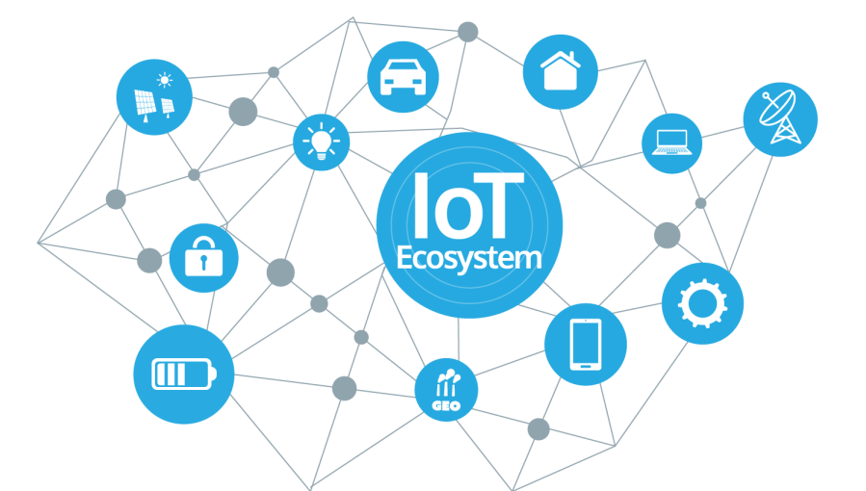
Privacy Preservation
[3] explores IoT network risks and experiments with security techniques
Inexpensive home automation network
  Used for attack and defense studies
Focus on privacy preservation in home automation networks
  Integral to achieving the promise of IoT

Slide 12
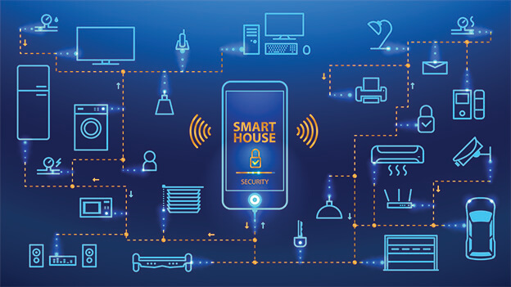
Why Use A Smart Home?
Large variety of sensor applications
  Thermostat, door locks, cameras, etc.
Variety provides for wide range of possible attacks
Minimal cost (COTS)
Provides insight into other IoT applications
  Industrial systems, automobiles, etc.

Slide 13
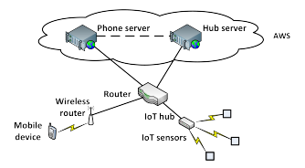
Network Architecture
SmartThingsTM hub and several SmartThings sensors comprise the IoT portion of the architecture

Slide 14
Network Traffic Analysis
Packets captured via tcpdump
IoT hub establishes TCP connection with server, builds SSL connection
Hub periodically checks in with server (ping)

Slide 15
Privacy Preserving Techniques
Conceal location information
Manipulate event reporting

Slide 16
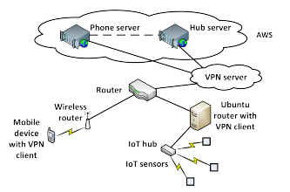
Location Concealment
Architecture with added VPN for concealment

Slide 17
VPN Setup
Two VPNs set up
  VPN in New York City (NYC) using OpenVPN
  Second VPN in San Francisco (SFO) for validation
NYC was successful in masking the true hub IP address
  VPN overlay did not cause any failures in SmartThings network
SFO further validated preservation of functionality

Slide 18
VPN Shortcomings
Delay
  Significant delay in keepalive (KA) message send and acknowledgement:
    Without VPN: 0.778ms
    NYC: 13.97ms
    SFO: 155.23ms
Lack of notification for momentary loss
  Two open/close tests with VPN switch in the middle
  No report of server being inactive
  Momentary loss followed by appearance at different IP address significant
    Could indicate man-in-the-middle attack

Slide 19
Manipulation of Event Reporting
Timing and frequency of sensor events reveals information about private behavior and daily patterns
Three classes of event manipulation techniques
  Delaying events
  Inserting events
  Dropping events

Slide 20
Baseline
Open/close testing at 30 second intervals
Initial TTL of 50 for open event, 100 for closed
SSL encryption led to indistinguishable packets
  Event notifications from hub: 109 bytes
Selective manipulation not possible
  Packets looked same across all sensors, couldn’t determine individual device packets

Slide 21
Delaying Events
Modified open/close
Drop TCP used to drop all packets between hub and server after close
Packets arrived after rule removal with timestamps reflecting drop time
Conditional actions also delayed as result

Slide 22
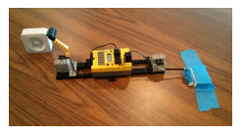
Inserting Events
Used LEGO MINDSTORMS robot to periodically trigger open/close sensors
False events filtered at the application level
  Reconstructs true behavior
  Confuses adversary
Can also plant dummy sensors so user
knows what to ignore

Slide 23
Dropping Events
Drop TCP packets until hub’s buffer is full
Maintain intermittent connectivity
  Make it look like connectivity issues in home network to observer
Less interesting for privacy protection, but could be utilized by attackers
  Disrupt event reporting, prevent actions from happening

Slide 24
Key Management Protocol
[4] discusses the design of a lightweight three-factor remote user authentication scheme for Hierarchical IoT Networks (HIoTN)
  HIoTN has need for direct real-time data access
Called User Authenticated Key Management Protocol (UAKMP)
Three factors:
  User smart card
  Password
  Personal biometrics

Slide 25
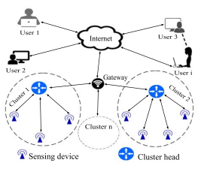
Network Model

Slide 26
UAKMP Phases
Offline sensing node registration
User registration
User login
Authentication and key agreement
Password and biometric update
New sensing node deployment

Slide 27
Phase Breakdown
Offline sensing node registration:
  Gateway node preloads necessary info in each deployed sensor node’s memory
    Happens prior to deployment
  Gateway node originates information
    Identity
    Temporal credential
User registration:
  User registers themselves at gateway node to access sensing nodes
  Gateway node generates smart card for user, transmits it to them

Slide 28
Phase Breakdown
Login phase:
  Gateway node acts as bridge between user and sensor node
  User must send login request to gateway node to access info
Authentication and key agreement:
  Gateway node generates authentication request to desired sensor node
    Accomplished via the sensor node’s cluster head
  Two types of mutual authentications:
    Between user and gateway node
    Between gateway node and sensor node
  User and sensor node generate shared session key for future secure communications

Slide 29
Phase Breakdown
Password and biometric update:
  User may need to update password and/or biometrics for security reasons
New sensing node deployment:
  Nodes may become compromised
    Physically by adversary
    Battery power exhausted
  Need to be able to deploy new nodes and replace existing ones as needed

Slide 30
Formal Security Analysis
Focused on adversary attempting to break SK security
Utilizes real-or-random model
  Randomly generated responses
Performed semantically, but successfully

Slide 31
Informal Security Analysis
Stolen Smart Card Attack
  ID and password still protected, preventing access
Privileged-Insider Attack
  Privileged-insider user tries to retrieve credentials of legitimate user from smart card
  Still need user biometrics and password (three-factor)
User Impersonation Attack
  Still need biometrics, so this fails
Five other informal attacks analyzed (node impersonation, node capture, bypass, etc.)

Slide 32
Formal Security Verification with AVISPA
Simulation study using AVISPA
  Automated Validation of Internet Security Protocols and Applications
  Push-button tool for automated validation
  Integrated with four back-ends
Three verifications performed:
  Executability checking on nontrivial specifications
  Replay attack checking
  Dolev-Yao threat model checking
All three verifications satisfied with short check times
  Means replay and man-in-the-middle attacks are protected against

Slide 33
Drawbacks to UAKMP
Highly semantic and theoretical
Not deployed in a fully-realized environment
  Authors look to do so in the future
Components designed to fit simulation, but still not used in production
Both of the prior papers only patch the current network

Slide 34
Different Network Architectures

Slide 35
New Proposed Architectures
Named Data Networking (NDN) in IoT
Software Defined Networking (SDN) in IoT

Slide 36
Named Data Networking in IoT
[2] proposes the use of NDN in an IoT space
Current host-to-host communications difficult in highly heterogeneous environment
  Multiple interfaces
  Various security regimes
  Must communicate locally and globally
NDN allows developers to work with devices and data directly

Slide 37
Named Data Networking
Proposed future internet architecture
Part of the field of Information Centric Networking (ICN)
Shifts focus from hosts to data
NDN disseminates named data at the network level
  Forwards names with application semantics
Data secured at time of production
NDN allows for naming of things in IoT
  Ex. Calling a smart bulb by name instead of denoting it by an IP address

Slide 38
Use Cases [2]
Smart homes
  Already discussed in [3]
Personal health and wellness applications
  Systems on Chips (SoCs) in wearable devices
  Utilize machine learning to decipher meaningful patterns
  Monitor physical activity, body temperature, heart rate, etc.
Precision agriculture industry
  Improve productivity and yield
  Ex. Fujitsu uses IoT devices to control greenhouses

Slide 39
Basic Protocol
Named Data Retrieval is the core of NDN
“Thin waist” of communication is now Data packets
User sends Interest packet with name of desired data
NDN network uses name to retrieve data, sent in Data packet
  Hierarchical name structure
  Components can define scope of data, app-specific semantics, and unique identifiers
Naming structure of NDN matches well with that of IoT
  Ex. An Interest packet could use the name “/LivingRoom/Temperature” to retrieve the temperature in the living room of a smart home

Slide 40
Strengths of NDN in IoT
Data-centric security
Name-based forwarding
In-network storage

Slide 41
Data-Centric Security
NDN directly secures data at the network layer
  Each Data packet signed at production
    Binds name of payload and data
  Receivers can validate a Data packet no matter where or how they received it
  Only authorized parties can access data
  Combines with hierarchical name structure to make strong security measures

Slide 42
Data-Centric Security
NDN developers currently working on a broader range of application security
  Asymmetric RSA and ECDSA signatures
  HMACs and hash chains for typical IoT messages (lightweight approaches)
Focus on data security rather than channel security is a building block for meeting IoT security requirements
  Independent of specific communication technology
  Allows for heterogeneous network transversal without compromising security
  Allows for intermediate caching without need for node trust

Slide 43
Name-Based Forwarding
NDN forwards packets based on their names, not IP addresses
  Works well for IoT as it allows for the naming of things
At each hop, NDN forwarder checks for Data that matches the Interest in its storage
  Uses matched Data packet to satisfy Interest packet
  If no match is found, check Pending Interest Table (PIT), which holds recent Interests
  If same Interest has been recently forwarded, aggregate identical Interests
  Otherwise, record Interest in PIT, look up Interest in forwarding table, and propagate according to forwarding strategy
  Return Data packet by following the PIT trail of forwarders

Slide 44
In-Network Storage
Data-centric security allows for in-network storage (caching) without security concerns
NDN routers cache forwarded Data packets as possible
  Enables efficient data dissemination
  Allows for local recovery
  Persistent data repositories can also be used for long-term managed data storage

Slide 45
How NDN Combines with IoT
Naming things, devices, and their data
Bootstrapping and discovery of unnamed nodes
Schematizing trust
  Data packets carry name and signer’s name
Name-based access control
  NAC utilizes additional access control namespace
Data aggregation

Slide 46
NDN Implementations in IoT
NDN-BMS
  Designs and implements NDN-based building management system for facility personnel
  Prototype deployed at UCLA
NDN-IoT
  Dev toolkit for smart home networks running on Raspberry Pi
NDN over Arduino
  Uses special version of NDN library called NDN-CPP Lite developed by authors
NDN-ACE
  Access control framework on constrained IoT devices

Slide 47
SDN-Based Architecture for IoT
[1] presents a Software Defined Networking (SDN)-based architecture
  Allows for networking with or without infrastructure
  Called an SDN domain
  Includes wired network, wireless network, and Ad-Hoc networks
Second architecture proposed to include sensor networks in domain
Authors interconnect these domains and discuss how to enhance security without compromising security of individual domain
Also propose new secure and distributed architecture for IoT

Slide 48
Software Defined Networking
New paradigm for innovation in networking research and development
  Control and data planes decoupled
  Network intelligence and state centralized
Controller connects to switch through OpenFlow channel
  Manages switch via OpenFlow Protocol
  Can add, update, and delete flow entries
SDN enables quick responses to security threats, granular traffic filtering, and deployment of dynamic security policies

Slide 49
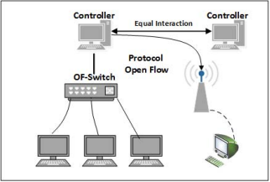
SDN Architecture
Equal interaction means all controllers have read/write access to the switch, which means they have to synchronize in order not to step on each other’s feet

Slide 50
SDN Architecture
SDN provides a programmatic interface inside the controller
  Allows network control operations to:
    Run on top of one or more server platforms with higher performances
    Use vendor-independent hardware
    Use an open operating system
    Communicate with other operating systems or control platforms using standard protocols

Slide 51
SDN for Ad-Hoc Networks
Authors propose a Multiple SDN Controller architecture for ad-hoc networks
  Ad-hoc networks connect devices directly without routers
Ad-hoc network nodes are viewed as a combination of
  Legacy interfaces (physical layer)
  Programmable layer (SDN-compatible virtual switch and SDN controller)
  Operating system and applications (OS layer)

Slide 52
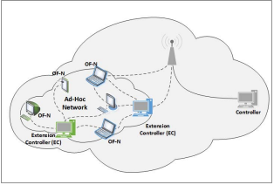
SDN for Ad-Hoc Networks
All legacy interfaces connected to virtual switch, which is controlled by SDN controller
Nodes will connect to each other through embedded SDN-compatible switch
Compatible with SDN legacy network, allowing for design of extended network

Slide 53
SDN Architecture for IoT
Traditional network elements are not designed for high scalability, traffic, or mobility
The authors look to adapt two primary elements to IoT:
  SDN domain
  SDN domain interconnection

Slide 54
SDN Domain in IoT
In an IoT network, devices can’t have an embedded SDN compatible switch or controller like mentioned previously
Solution: Connect each device to a neighbor node with SDN compatibility
  This is because many sensor nodes are low-resource
Each domain has its SDN controller to control all traffic in its domain

Slide 55
SDN Domain Interconnection
In an architecture with multiple domains, we assume each domain has at least one SDN controller
  Controller manages only device in its domain
  Domain represents enterprise network or datacenter
Heterogeneity is a must in SDN for IoT
  To achieve this large-scale interconnectivity, the root (or border) controller is introduced
  Routing functions and security rules distributed across border controllers
  Border controllers act as a connection point to other border controllers

Slide 56
Distributed SDN Security
The authors designed an extended secure SDN-based architecture for IoT
  Controller manages security of a single domain
  This is extended to multiple controllers in regard to available resources
  Extend distributed control by interconnecting all domains via border controllers
To secure network access and resources:
  SDN controllers must authenticate network devices
  Once OpenFlow secure connection is established, controller blocks user’s active ports
    Prevents other traffic from reaching user
  Controller authorizes only user’s authentication traffic
  Appropriate flows will be pushed after authorization

Slide 57
Distributed SDN Security
Concept of the security grid is to extend concept of domain to multiple domains
SDN controllers act as security guards at the edge of the extended domain
  Ensures network safety
Safety connections funneled through SDN controllers
Security controllers in every domain would prevent users from opening unauthorized new services
  Communication ports must be requested via SDN controller
Extended SDN controllers periodically monitor and check flow table entries of software switches (user-side)

Slide 58
Conclusion
Current IoT networks have issues with security, among other things
  Network architecture not designed for IoT
  Poor local communication in IP scheme
  Hard to implement even simple communications
  Channel and session security doesn’t fit with IoT
Patchwork solutions help but don’t fully remedy the issue
A network redesign can be conducive to a more secure IoT environment

Slide 59
References
O. Flauzac, C. González, A. Hachani and F. Nolot, "SDN Based Architecture for IoT and Improvement of the Security," 2015 IEEE 29th International Conference on Advanced Information Networking and Applications Workshops, 2015, pp. 688-693, doi: 10.1109/WAINA.2015.110.
W. Shang et al., "Named Data Networking of Things (Invited Paper)," 2016 IEEE First International Conference on Internet-of-Things Design and Implementation (IoTDI), 2016, pp. 117-128, doi: 10.1109/IoTDI.2015.44.
M. R. Schurgot, D. A. Shinberg and L. G. Greenwald, "Experiments with security and privacy in IoT networks," 2015 IEEE 16th International Symposium on A World of Wireless, Mobile and Multimedia Networks (WoWMoM), 2015, pp. 1-6, doi: 10.1109/WoWMoM.2015.7158207.
M. Wazid, A. K. Das, V. Odelu, N. Kumar, M. Conti and M. Jo, "Design of Secure User Authenticated Key Management Protocol for Generic IoT Networks," in IEEE Internet of Things Journal, vol. 5, no. 1, pp. 269-282, Feb. 2018, doi: 10.1109/JIOT.2017.2780232.

